Slide 1
Retail Store Sales Performance & Inventory Optimization
A comprehensive Power BI analytics report covering sales trends,
inventory risks, marketing patterns & cross-category insights

Slide 2
Agenda
1
Project Context & Objectives
2
Data Overview & Preparation
3
Executive Sales Overview
4
Growth Story 2022 → 2023
5
Inventory Optimization
6
Marketing & Customer Insights
7
Store Performance & Basket Analysis

Slide 3
01
Project Context
& Objectives
Why this engagement existed

Slide 4
Project Context & Objectives
What the business needed — and what we built
THE CHALLENGE
OUR OBJECTIVES
A multi-format retail chain with 1M+ transaction records needed a single analytics solution to understand sales performance, identify inventory risk, and uncover customer purchasing patterns across 5 regions and 7 product categories.
Track total sales performance & profitability trends
Identify stockout risks before they impact revenue
Understand seasonal & customer loyalty patterns
Analyse store format efficiency (sales per sq ft)
SCOPE AT A GLANCE
Discover cross-category purchasing behaviour
10L+
500
55
6
Transaction
records analysed
Dim Products
records
Dim Stores
records
Dashboard
pages built
TOOLS & METHODOLOGY
Power BI (Power Query, DAX, Python Visual) Python (mlxtend — Apriori algorithm)
Star schema data model | 1 fact table + 3 dim tables | Date table (Calendar)

Slide 5
Data Overview: Column Selection & Removal Decisions
Clinic Dataset · Column-level decisions made before analysis
Columns Removed
Metrics Not Used in Analysis
Columns Retained for Analysis
▸ Star Score — redundant with star_rating2
▸ Haemorrhoids — no values present
▸ Bunion — no values present
▸ Online — felt irrelevant to review quality analysis
▸ Sentiment — text labels didn't align with numeric star rating
▸ Polarity score — scores inconsistent with star rating distribution
▸ Both columns retained in raw data but excluded from visualizations.
▸ star_rating — primary performance metric
▸ published_date — converted to short date
▸ Company / Type — competitor grouping
▸ Cleanliness — standardized values
▸ Experience — standardized values
▸ Cost — cleaned missing values
▸ review_body — qualitative context

Slide 6
Data Cleaning: Standardisation & Value Corrections Applied
TBL Dataset · Row-level and value-level cleaning steps
Zero / 'O' Values — All Columns
Cost Column — Missing Value Fix
▸ All columns containing 'O' (letter O used as zero) identified and handled
▸ Affected rows reviewed individually to confirm correct null treatment
▸ Ensures numeric aggregations (averages, counts) are not distorted
▸ One row contained a stray apostrophe ' as the entire cell value
▸ Replaced with: "No cost experience mentioned" — consistent with other null cost rows
▸ Maintains uniformity across the cost category for analysis
Published Date — Format Standardisation
Average Rating — Private Clinic Calculated
▸ published_date column stored as serial numbers (e.g. 42781.7…)
▸ Converted to short date format: DD/MM/YYYY
▸ Enables correct chronological sorting and year-based aggregation
▸ Average star_rating computed specifically for The Private Clinic rows
▸ Used as the Target benchmark across all competitor comparison charts
▸ All-time average: 4.72 · Yearly breakdown used in trend line chart

Slide 7
Data Cleaning: Category Standardisation & Sentiment Outliers Removed
TBL Dataset · Category value fixes and problematic sentiment rows
Category Value Standardisation
Sentiment Column — Problematic Rows Identified & Excluded
▸ Cleanliness column:
▸ "washed" → "clean" (aligned to standard category label)
▸
▸ Experience column:
▸ "pain" → "painful" (consistent with category schema)
▸ "recovery" → "recoverable" (consistent with category schema)
▸ These fixes ensure pivot tables and bar chart groupings are accurate
▸ Row 1 — Full review text placed in Sentiment field:
▸ "Both my sister and I chose the hospital group… It took three additional phone calls to have this corrected, thanks to Diane." — Review body incorrectly mapped to sentiment column
▸
▸ Row 2 — Incomplete fragment in Sentiment field:
▸ "long may it continue on my journey." — Partial phrase with no analytical value
▸ Both rows excluded from sentiment/polarity metrics; review_body data preserved

Slide 8
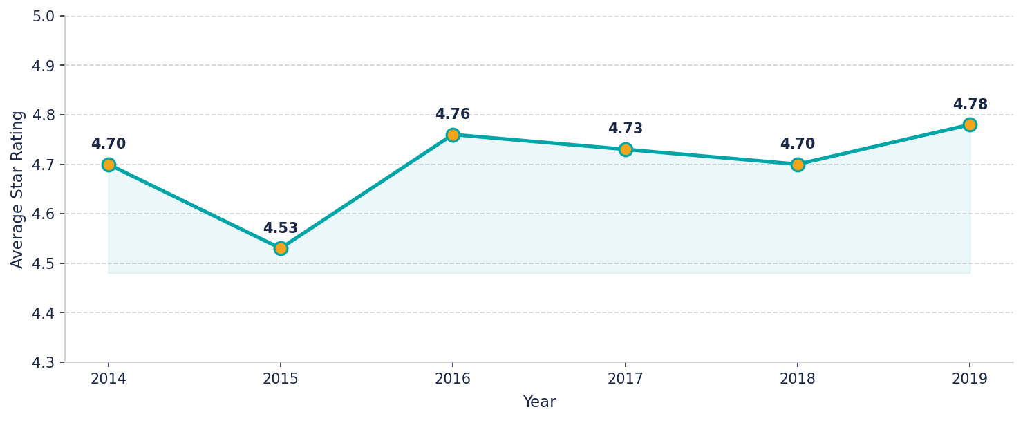
How has The Private Clinic's average rating trended over time?
How has The Private Clinic's average rating trended over time?
Average Rating of The Private Clinic · 2014–2019
Key Insights
▸ Ratings dipped in 2015 (4.53) before recovering strongly
▸ Consistent improvement from 2015 to 2019, reaching 4.78
▸ Overall all-time average stands at 4.72 — well above industry benchmarks
▸ 2019 marks the highest rated year across the full period

Slide 9
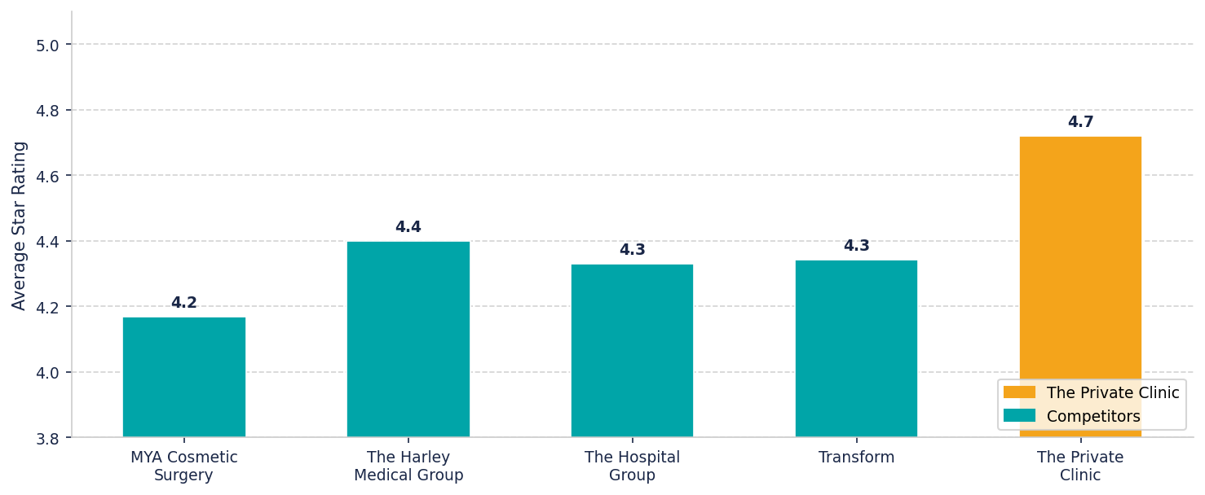
The Private Clinic outperforms all direct competitors on star rating
The Private Clinic outperforms all direct competitors on star rating
Average Star Rating · The Private Clinic vs Direct Competitors
Key Insights
▸ The Private Clinic leads direct competitors with a 4.72 average rating
▸ MYA Cosmetic Surgery scores lowest among direct rivals at 4.17
▸ The Harley Medical Group is the closest competitor at 4.40
▸ A ~0.43 point gap separates The Private Clinic from the direct average (4.29)

Slide 10
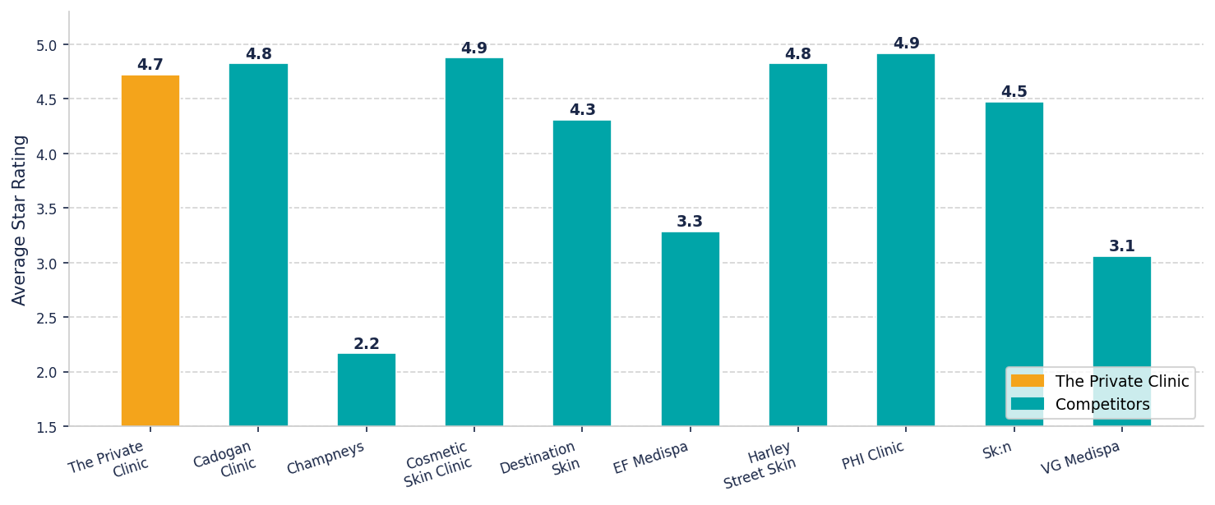
Mixed picture vs wider industry — The Private Clinic trails a select few
Mixed picture vs wider industry — The Private Clinic trails a select few
Average Star Rating · The Private Clinic vs Wider Industry Competitors
Key Insights
▸ PHI Clinic (4.92) and Cosmetic Skin Clinic (4.88) outperform The Private Clinic
▸ Champneys (2.17), VG Medispa (3.06) and EF Medispa (3.29) rate significantly lower
▸ The Private Clinic(average 4.7) sits above the wider industry average of 4.32
▸ Harley Street Skin and Cadogan Clinic are closest rivals at 4.82

Slide 11
Cleanliness ratings are uniformly high — The Private Clinic matches competitors
Cleanliness ratings are uniformly high — The Private Clinic matches competitors
Cleanliness Category · % of Reviews Mentioning "Clean" · Competitors
Key Insights
▸ The Private Clinic scores 100% clean mentions — equal to top direct rivals
▸ All direct competitors except MYA (95.2%) score 100% on cleanliness
▸ Cleanliness is a hygiene factor — consistent across all direct competitors

Slide 12
Surgery experience: The Private Clinic performs competitively on pain mentions
Surgery experience: The Private Clinic performs competitively on pain mentions
Surgery Experience · % of Reviews Mentioning "Painful" · Competitors
Key Insights
▸ The Private Clinic (81.1% painful) is mid-range among direct competitors
▸ The Sk!n has the highest painful mention rate at 96.8%
▸ The Harley Medical Group performs best at 73.3% painful mentions
▸ Lower painful % and higher recoverable % indicates better patient experience

